Slide 1
TRANSMITARRAY ANTENNA Beamsteering
Tuan-Phong Nguyen

Slide 2
CONTENT
Beamsteering with a transmitarray
Unit-cell design
Simulation

Slide 3
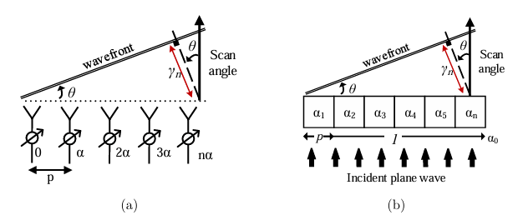
Beamsteering with a transmitarray
1. 1D-beamsteering
1D – traditional transmitarray vs linear antenna array comparison:
Linear antenna array: the phase shifting is applied to the signal in each individual branch using a phase shifter.
Transmitarray: the phase shifting is obtained by controlling the phase delay introduced by each individual elements
Linear antenna array
1D transmitarray

Slide 4
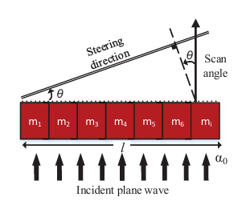


Beamsteering with a transmitarray
1. 1D-beamsteering
The different phase shift after penetrating each N element of the array:
The transmission phase in each element:
The phase different between adjacent elements:
By varying the phase αi of each array element in an progressive way ψ , the incident wave can be steered with a desired direction θ relative to the normal.

Slide 5
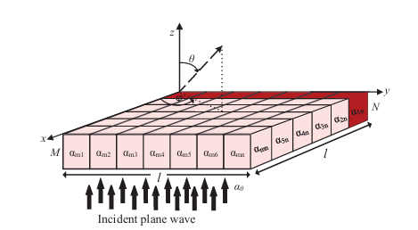

Beamsteering with a transmitarray
2. 2D-beamsteering
A progressive phase between adjacent elements should occur along the X and Y direction of the M x N array. The relation between the two-dimensional output directions (θ, φ) and the progressive phase delay is given by
ψx and ψy are the progressive phases along X and Y axis, respectively, and p the periodicity of the elements of the array.

Slide 6
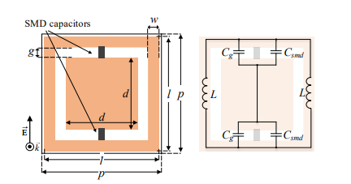

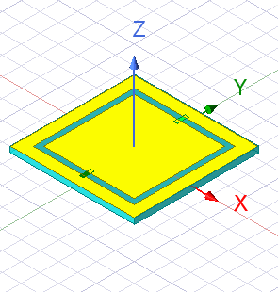
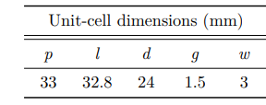
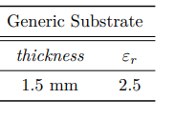
Unit Cell Design
1 layer
F = 5.3 GHz
The resonant frequency:
Square-slot unit-cell design employing SMD capacitors.
HFSS design

Slide 7
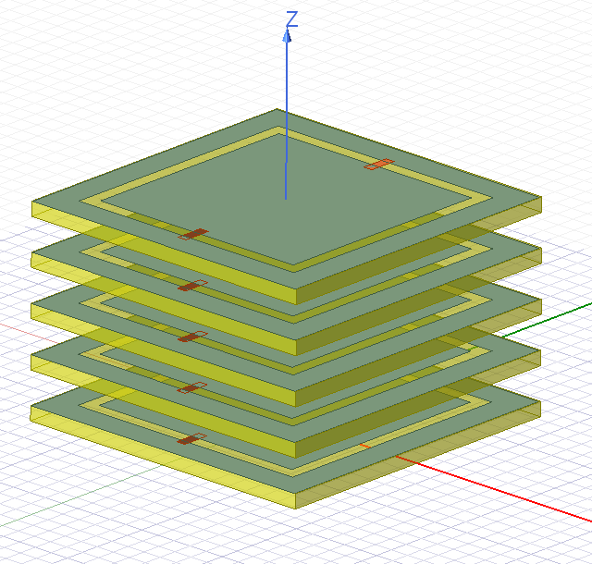
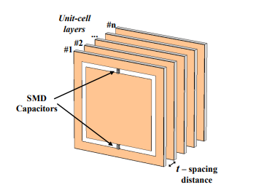
Unit Cell Design
n layer
F = 5.3 GHz
Stacked layers of unit-cells to increase transmission phase
5 layers
t = 3.5mm (= 𝞴/16)

Slide 8
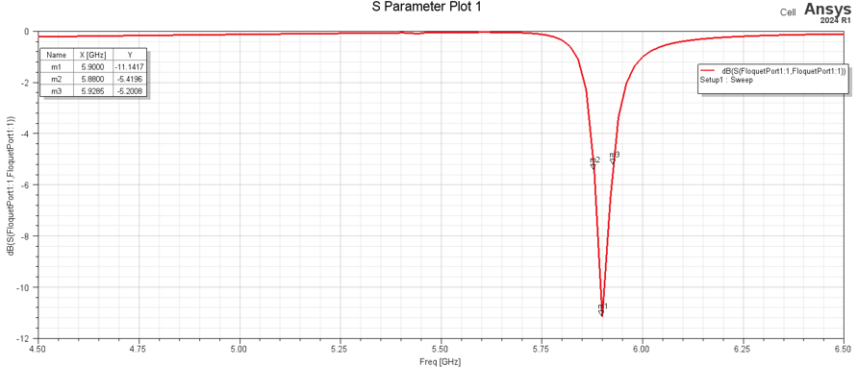
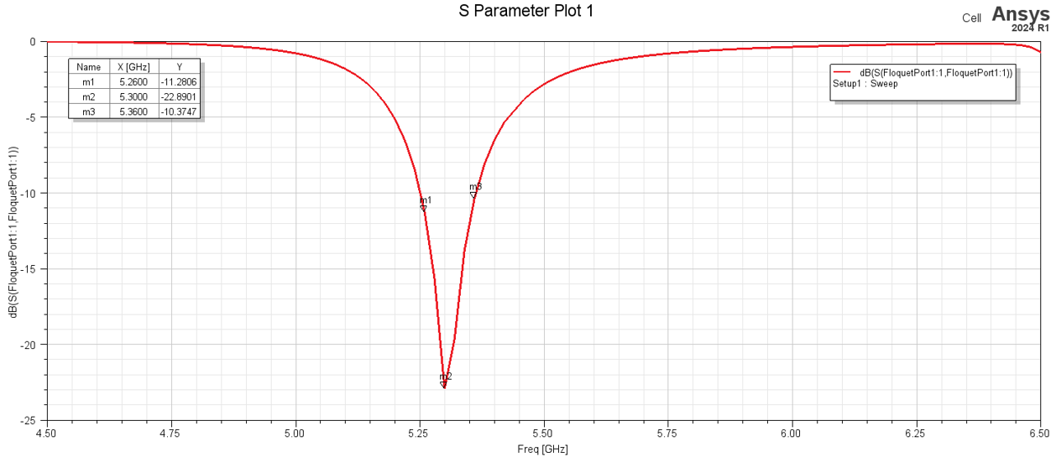
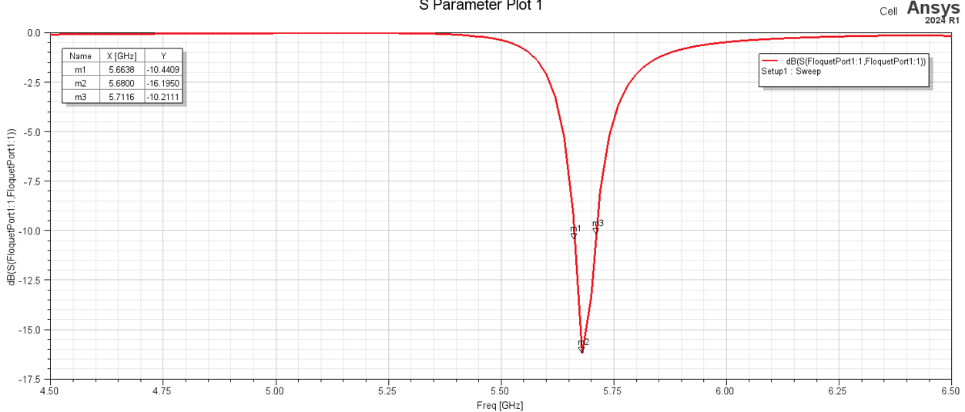
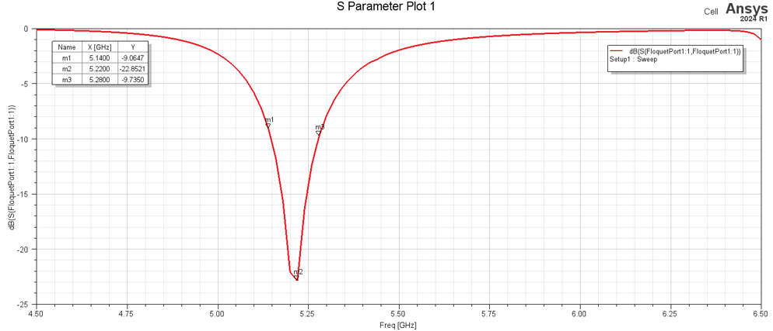
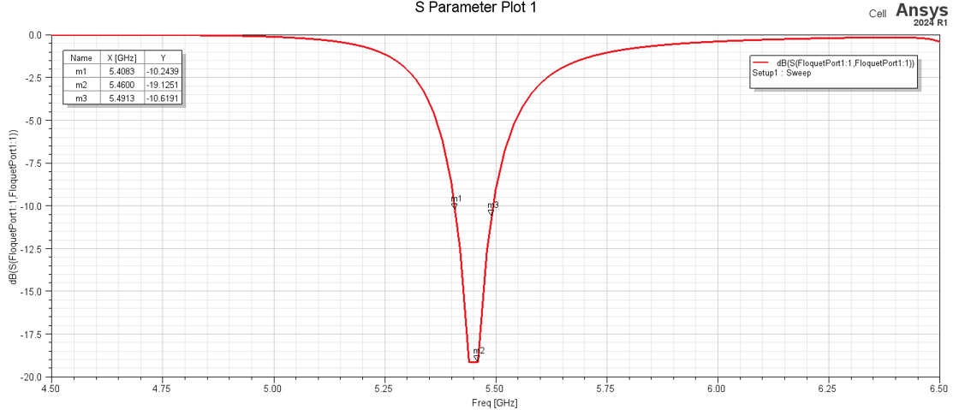
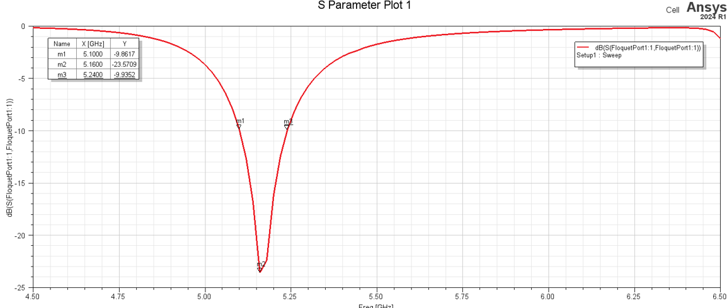
Simulation
S11 (1 layer)
C = 0.7 pF
fc = 5.88 GHz
C = 2 pF
fc = 5.3 GHz
C = 1 pF
fc = 5.68 GHz
C = 2.5 pF
fc = 5.22 GHz
C = 1.5 pF
fc = 5.458 GHz
C = 2.8 pF
fc = 5.165 GHz

Slide 9
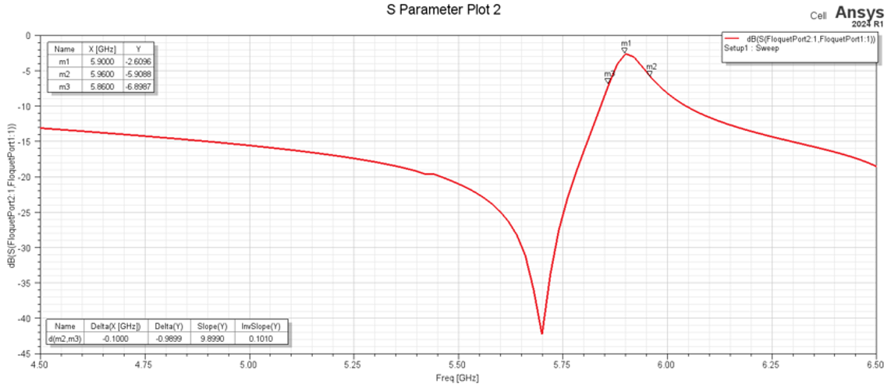
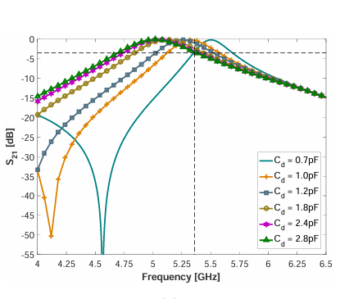
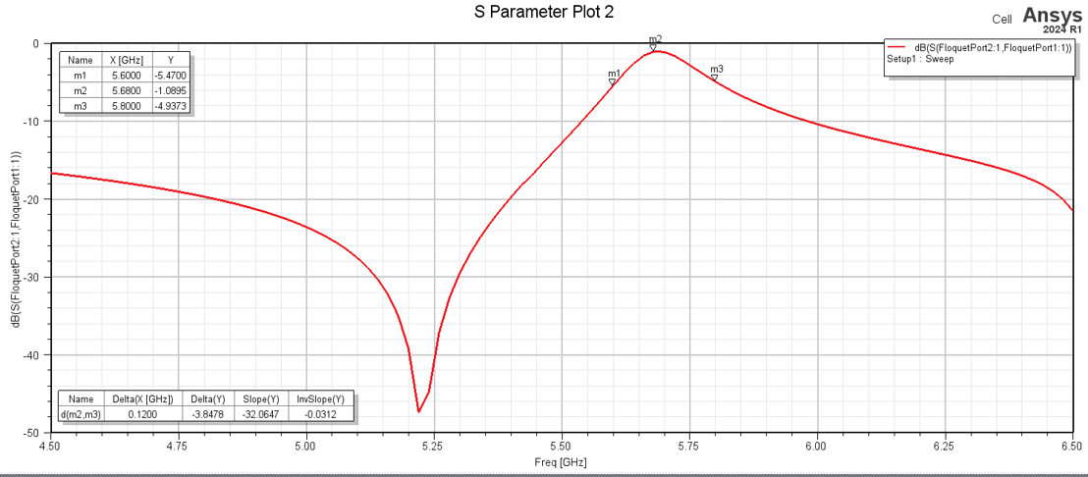
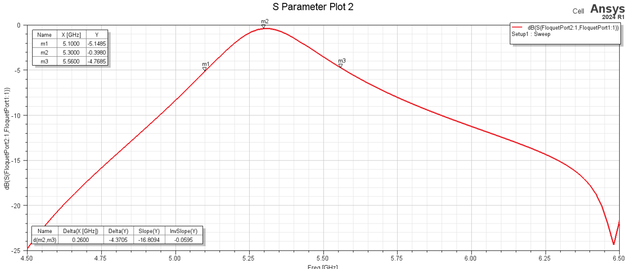
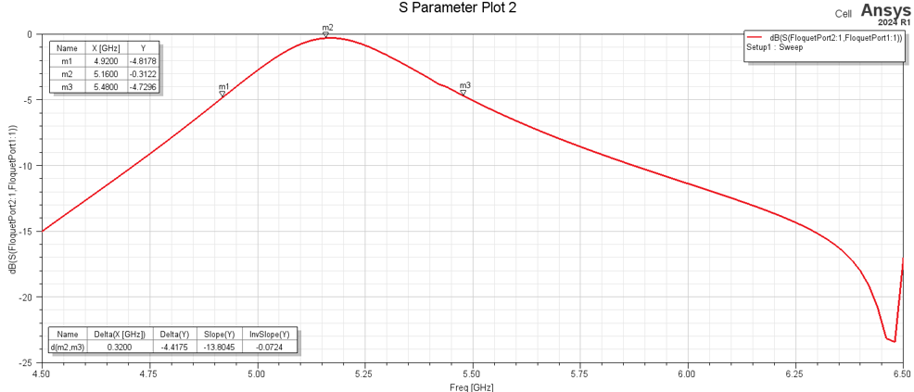
Simulation
C = 0.7 pF
S21_Mag (1 layer)
C = 1.0 pF
C = 2.0 pF
C = 2.8 pF

Slide 10
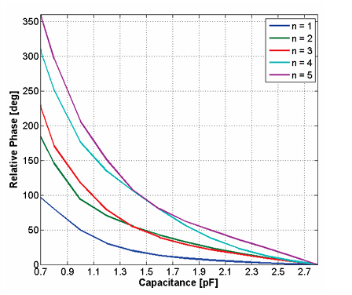
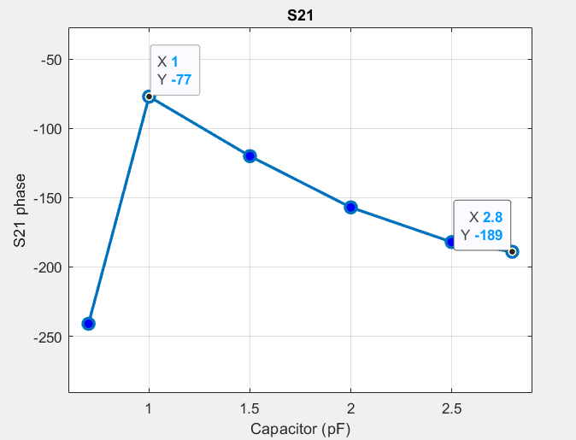
Simulation
S21_Phase (1 layer)

Slide 11
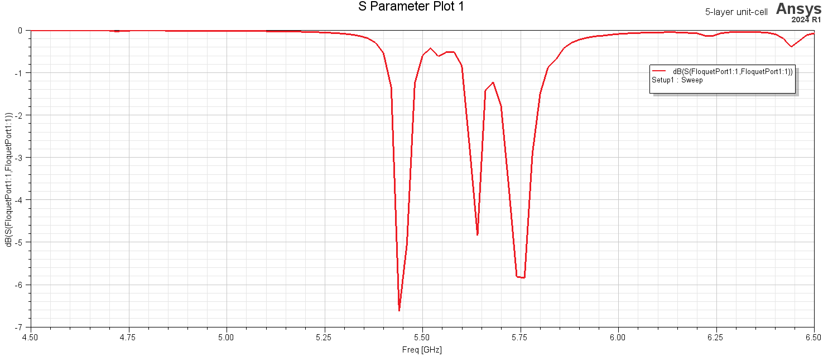
Simulation
S11 (5 layer)
C = 2.8 pF

Slide 12
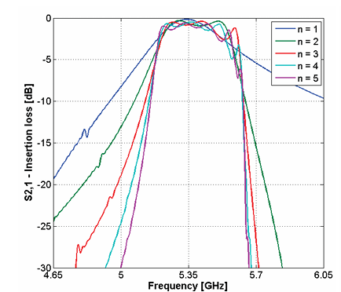
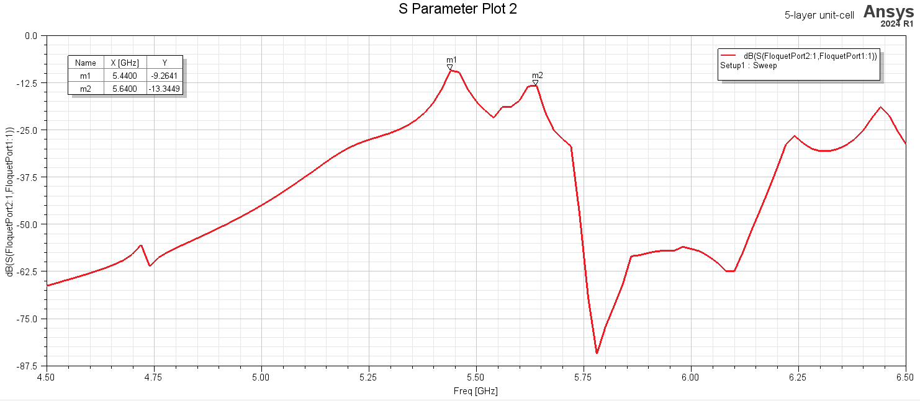
Simulation
S21_Mag (5 layer)
C = 2.8 pF

